Slide 1

Florida Association of the Deaf
2025 Election Meeting
November 15, 2025
Via
ZOOM

Slide 2
Official Announcement / Notice to Members
Subject: Notice of Postponed Election of Officers
The Florida Association of the Deaf (FAD) announces that the election of officers, originally scheduled to take place during the biennial conference, will instead be held as a postponed election at a special meeting on Saturday, November 15, 2025, to be conducted online via Zoom.
In accordance with Robert’s Rules of Order Newly Revised (12th ed.), the failure to hold an election at the prescribed time does not invalidate the election when later held. Current officers continue to serve until their successors are elected and qualified.
All members in good standing are eligible to participate, nominate, and vote.

Slide 3
Official Announcement / Notice to Members
Subject: Notice of Postponed Election of Officers
FAD By-Laws 5.4 Special Meetings
Special meetings may be called upon the request of the President or any three (3) Board elected or appointed members. Notification shall be given to the Executive Board of Directors at least seven (7) days prior to the meeting. Such meetings may be held by electronic conference or similar video communication methods. Electronic vote results shall be ratified at the next executive Board Meeting.

Slide 4
ELECTION Process of FAD OFFICERS
FAD By-Laws 5.7 Quorum
A Quorum to conduct business at any annual, regular, special or committee meetings shall be a majority of the voting membership registered to attend the meeting. An exception to this rule shall be both bylaws and dissolution meetings in which the bylaws may be amended as specified in articles 8 and 9.

Slide 5
FAD Elections – November 15, 2025
ELECTION Process of FAD OFFICERS
Election Chairperson – Andy Lange
Election Committee Members – Dereck Horne, Lissette Wood and 1 additional member selected at the meeting.
Voting will be conducted by show of hands. When called for, please click on the “raise” hands button on zoom.
Votes for candidates will be counted by the Election Committee.
Majority vote holder WINS!

Slide 6
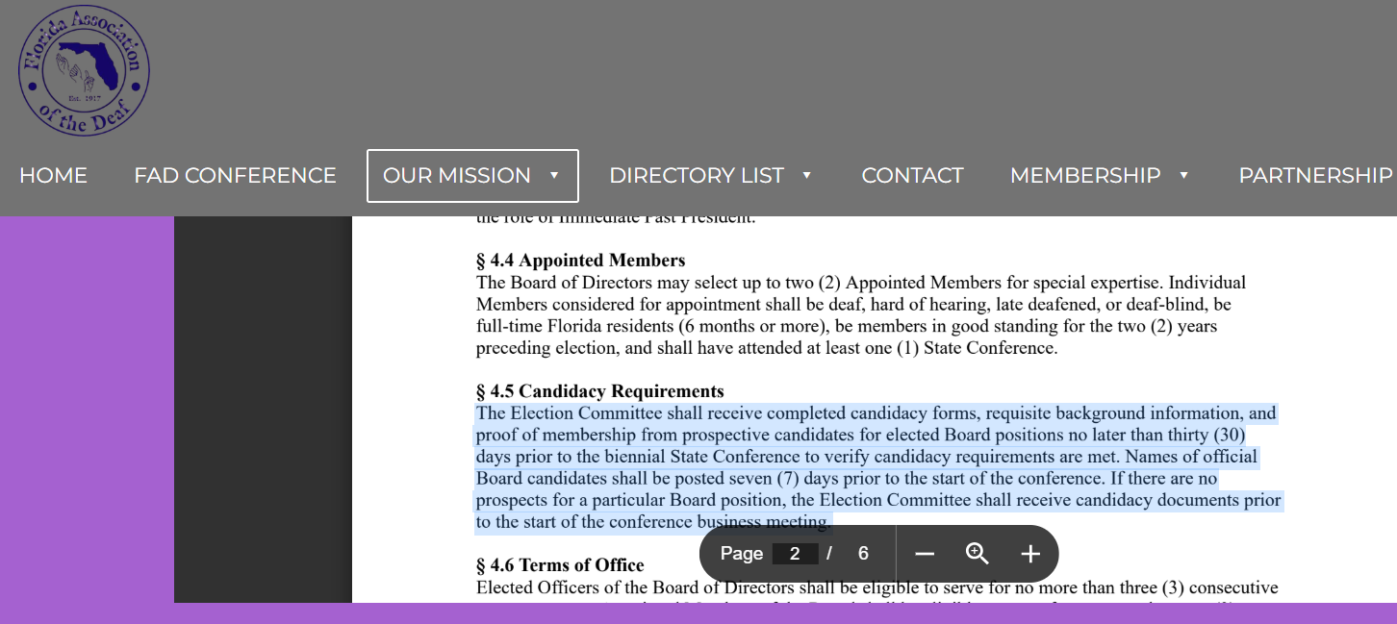
FAD Elections – November 15, 2025
ELECTION Process of FAD OFFICERS
By-Laws can be found on FAD Central Website: https://www.fadcentral.org/our-mission/bylaws

Slide 7
ELECTION Process of FAD OFFICERS
FAD By-Laws: 4.5 Candidacy Requirements
The Election Committee shall receive completed candidacy forms, requisite background information, and proof of membership from prospective candidates for elected Board positions no later than thirty (30) days prior to biennial State Conference to verify candidacy requirements are met. Names of official Board Candidate shall be posted 7 days prior to the start of the conference.
IF there are no prospects for a particular Board position, the Election committee shall receive candidacy documents prior to the start of the conference business meeting.

Slide 8
ELECTION Process of FAD OFFICERS
FAD By-Laws: 4.6 Terms of Office
Elected Officers of the Board of Directors shall be eligible to serve for no more than three (3) consecutive two-year terms. Appointed Members of the Board shall be eligible to serve for no more than two (2) consecutive two-year terms.
FAD By-Laws: 4.7 Assumption of office
Elected Officers shall assume their respective Board duties immediately after adjournment of the biennial State Conference. Appointed Members shall start their board duties no later than 60 days after the conference. Designated representatives of Affiliate Members shall start their respective Board duties no later than thirty (30) days after the conference.

Slide 9
ELECTION Process of FAD OFFICERS
FAD By-Laws 4.8 Duties of office
The Board of Directors shall have general control of the affairs of the Association between biennial State Conferences, during which time they shall consider action on conference recommendations and membership input. The board shall have the power to fill Board vacancies except for the office of president if these occur between biennial State Conference.
The Board shall undertake actions to ensure the financial health and growth of the Association and ensure that the expenditures of the Association shall not at anytime exceed the income for each fiscal year.
Everyone should read Section 4.9 and learn the duties of the Board of Directors.

Slide 10
ELECTION Process of FAD OFFICERS
FAD By-Laws 4.2 Elected Officers
The President, Vice President, Secretary, and Treasurer of the Board of Directors shall be elected by ballot at the biennial State Conference.
Individual Members who seek office shall be
1) deaf, hard-of-hearing, late-deafened, or deaf-blind,
2) be full-time Florida residents (6 months or more),
3) be members in good standing for the two (2) years preceding election, and
4) shall have attended at least one (1) State Conference.

